Slide 1
QWERTY, NHST, Nonparametric Statistics, and OOM
By Katy Valentine

Slide 2
Prospectus
What is NHST?
Where did NHST come from?
What is the QWERTY Effect?
What are alternatives to NHST?
Nonparametric Statistics
Observation Oriented Modeling
How can we apply these?

Slide 3
What is nhst?
NHST is a ritual in statistics whereby the researcher defines:
A null hypothesis (A = B)
And an omnibus binary decision criteria of p < .05

Slide 4
Where did nhst come from?
Fisher created a procedure for hypothesis testing whereby a hypothesis to be “nullified” was stated (ρ = .20) and an exact p-value was to be reported. This procedure was only to be used as a last resort.
Neyman-Pearson worked off this to create their decision theory where they implemented an alternative hypothesis, and discussed the necessary and adjustable alpha and beta levels. They emphasized the role of the researcher in the decision making process.

Slide 5
The qwerty effect
The phenomenon whereby words with more letters on the right side of the QWERTY keyboard are seen as more pleasant.
We wanted to take this a step further and look to see if pleasantness extended to other aspects of “typability”

Slide 6
The qwerty effect
To observe this we created a list of words that fell into one of three categories: repeated keystrokes not paired together (RN), repeated keystrokes together (RY), and not repeated with different fingers (DN). and then had students rate 120 of these 240 words on pleasantness. Half of these words were real words and half were pseudo words.

Slide 7
Word type examples
Table 1 Examples of word types.
Word Type | Real words | Pseudowords
Repeated keystrokes not together | milk | tofe
Repeated keystrokes together | kin | poom
Not repeated with different fingers | mop | hok

Slide 8
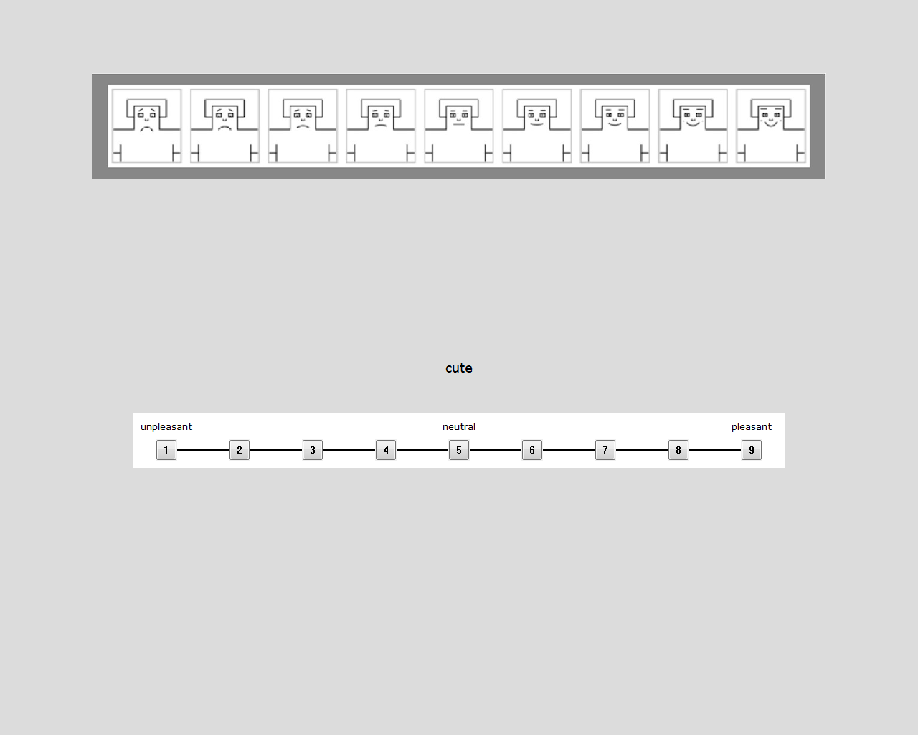

Slide 9
How to analyze in nhst
A repeated measures ANOVA would be run on this data for the 3 levels of typability.
But first, a number of assumptions must be checked.
Accuracy, Missing Data, Outliers, Normality, Linearity, Multicollinearity, Homogeneity, and Sphericity
But, there are alternatives!

Slide 10
Nonparametric statistics
Place less emphasis on assumptions
Use simpler models which require less calculation
Are based on simpler theories which allows a researcher to assess their data and choose the correct analysis
Are frequently more powerful than parametric statistics

Slide 11
Nonparametric statistics
For this set of data with several related samples we would use a Quade test to analyze the effect of typability on pleasantness rating.
Only has 3 assumptions which must be met
1. Variables are mutually independent,
2. Observations for each participant may be ranked according to some criterion
3. A sample range is capable of being determined within each block so they may be ranked.
The test focuses on the ranked observations within each block and the average participant rank for the different word types in this study

Slide 12
Observation oriented modeling
The new paradigm:
Basically no assumptions!
Shift from positivism to realism
Move away from population parameters and towards the individual
Need for integrated models with detailed framework

Slide 13
Observation Oriented modeling
The program:
Data for each individual is entered and broken into a binary code where it can be analyzed using various types of matrix algebra (with a specific focus on binary procrustes rotation)
Then an expected pattern is modeled. Based on this pattern the program compares each participant to see if they match the pattern partially (PC) or completely (PCC).
Based on these matches in the sample a c-value is computed based on bootstrapping. This value is not a p-value with a cut-off, but rather a secondary form of confirmation for the researcher that their results are distinctive

Slide 14
Observation Oriented modeling
For the data in the QWERTY experiment an ordinal pattern analysis would be used to determine how participants rated the types of words in relation to each other.

Slide 15
Proposed Data Analysis
NHST
Run a repeated measures ANOVA with post-hoc tests and effect size
Nonparametric Statistics
Run a Quade test with appropriate post-hoc tests
Compare NHST procedure and Quade test using G*Power to assess A.R.E.
Observation Oriented Modeling
Run an ordinal pattern analysis
Describe how these results differ from the previous two methods.

Slide 16
Questions?
???

